Slide 1
Students who struggle with Time Management
Adiao, Tingson

Slide 2
The Problem
Students’ struggle
Time management
Activities

Slide 3
Findings
Through interview question:
“Do you struggle with handling academics and your other activities? How? ”

Slide 4
Findings
School activities
Hobbies
Social Media
Overworking
Free time
Weekends

Slide 5
Findings
Fair GPA but stressed
Low GPA
Above Average
Procrastination
Big responsibilities
Time management

Slide 6
User Needs
Students need a way to organize their schedules and avoid unproductivity
Students need to receive reminders on what to prioritize

Slide 7
Point of View
Students always have academics, personal interests and other responsibilities to manage, plus an excessive usage of applications.
Why not all?

Slide 8
The Solution
Help arrange users’ activities
Help users in managing time

Slide 9
Storyboard
PHONOS

Slide 10
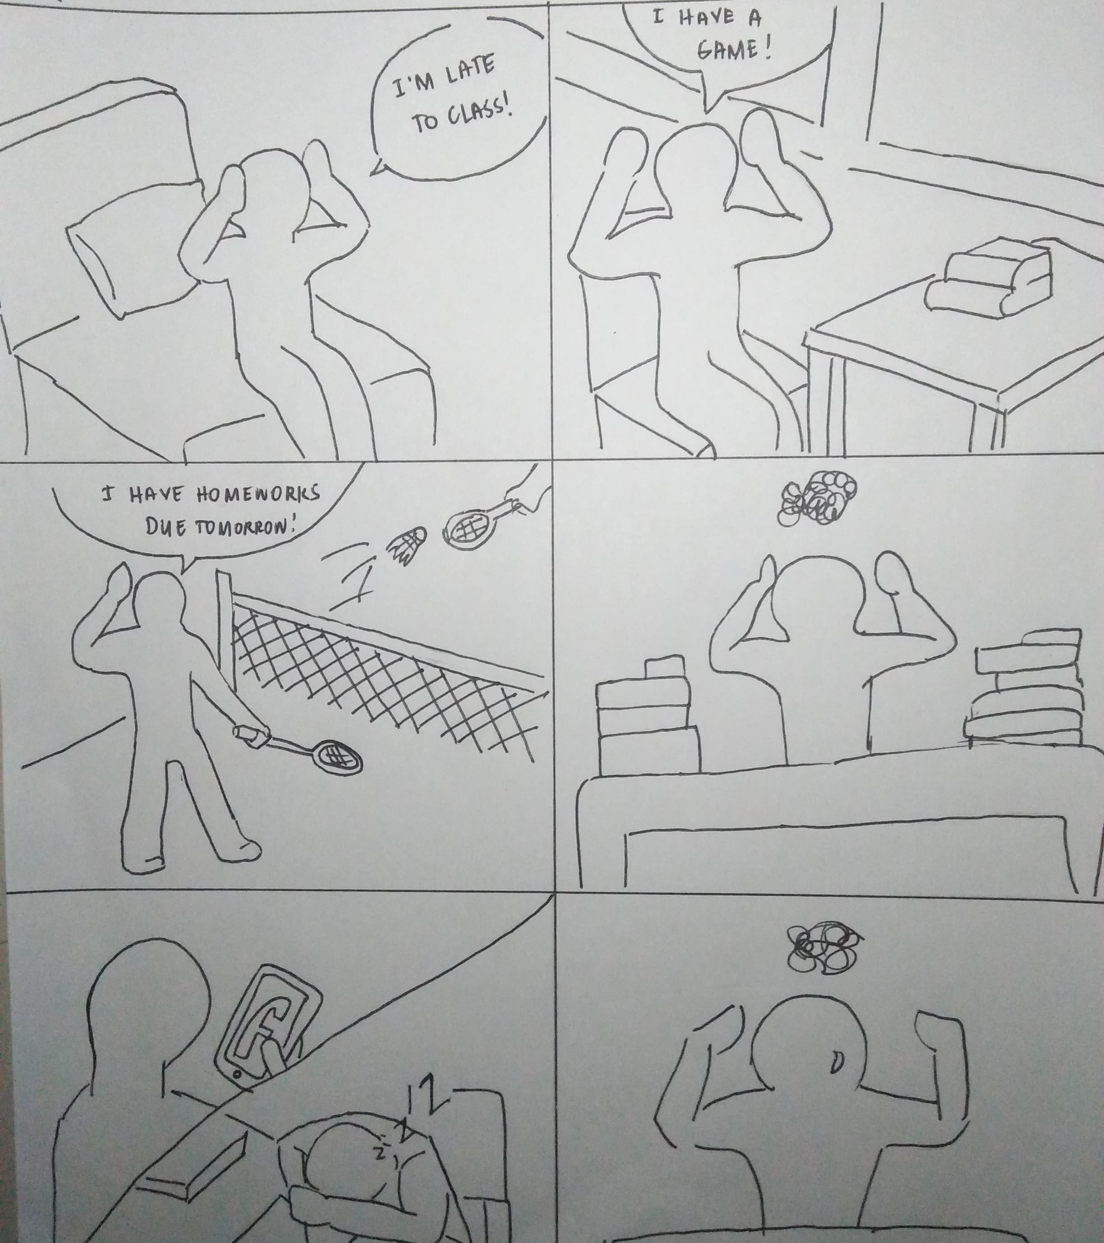
User Need
Rush on activities
Cause of panic
Unfinished tasks

Slide 11
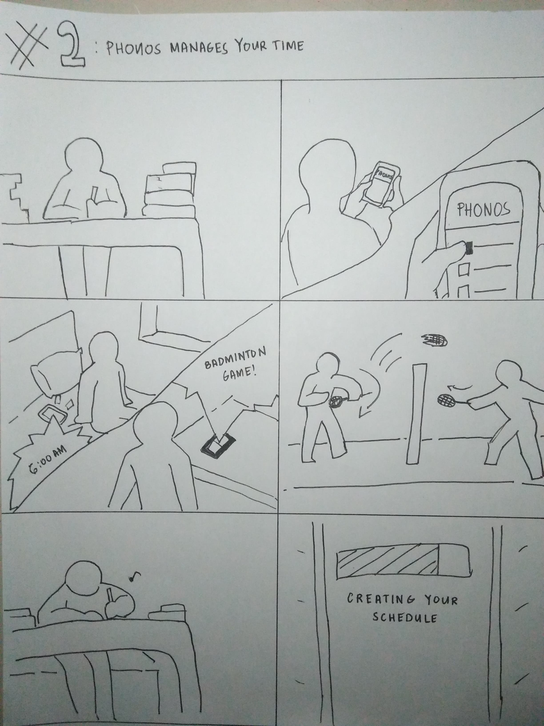
Manages Your Time
Tell the time
Suggests date and time

Slide 12
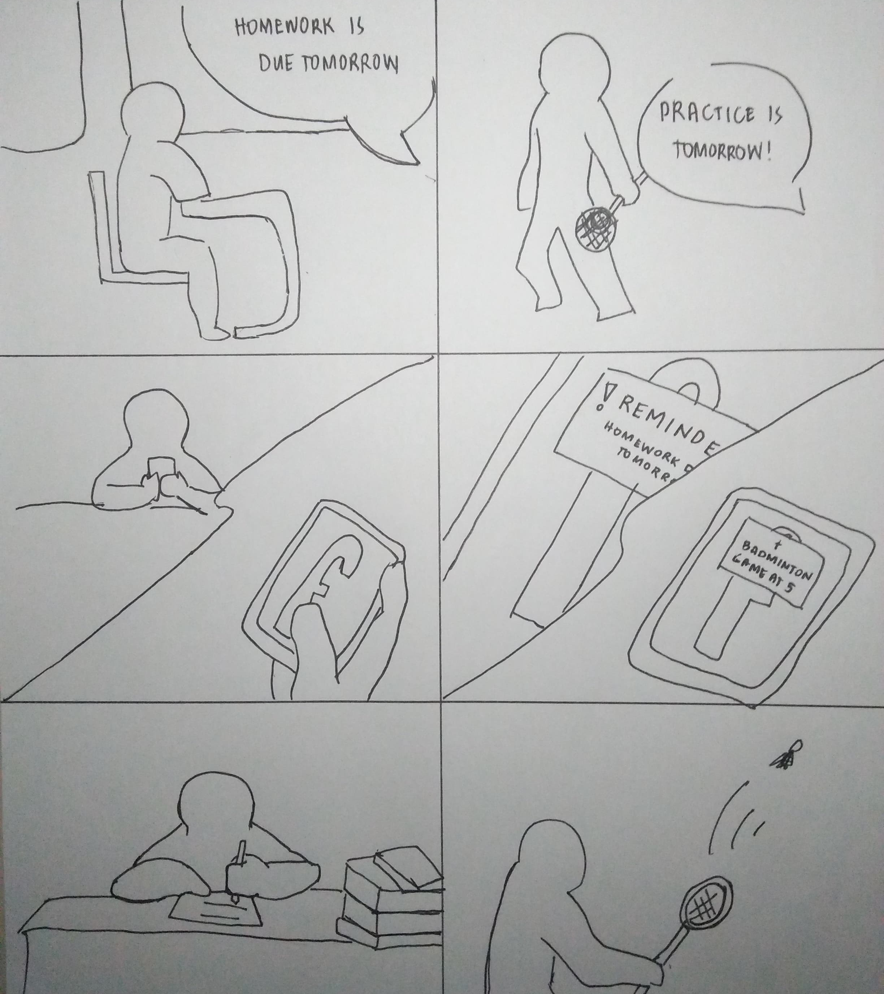
Keeps you productive
Reminder or alarm
Achievements or trophies

Slide 13
The Application
PHONOS

Slide 14
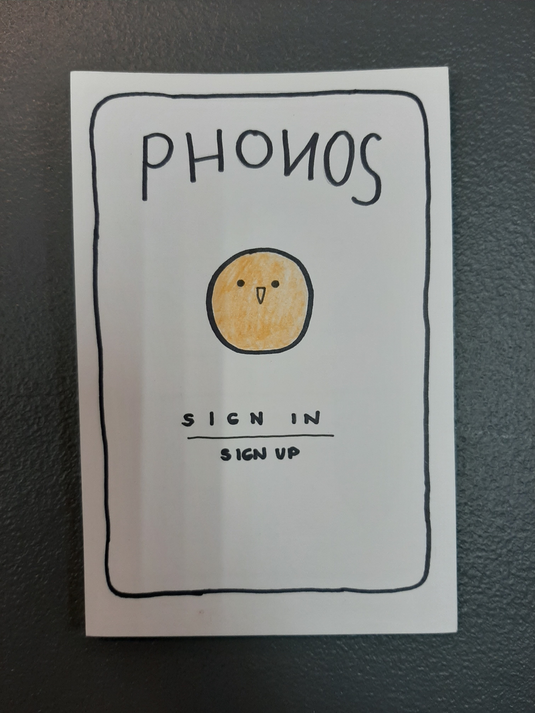
PHONOS
A. I. Powered Application
Ponos – god of hardwork
“The phone knows”

Slide 15
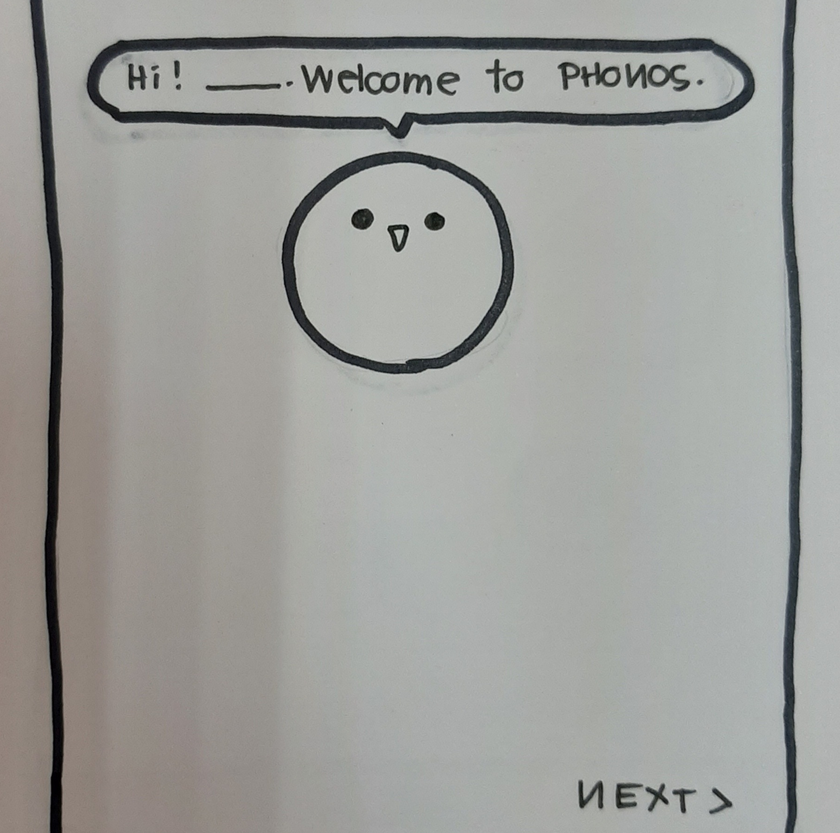
PHONOS
PEEN- the interactive character

Slide 16
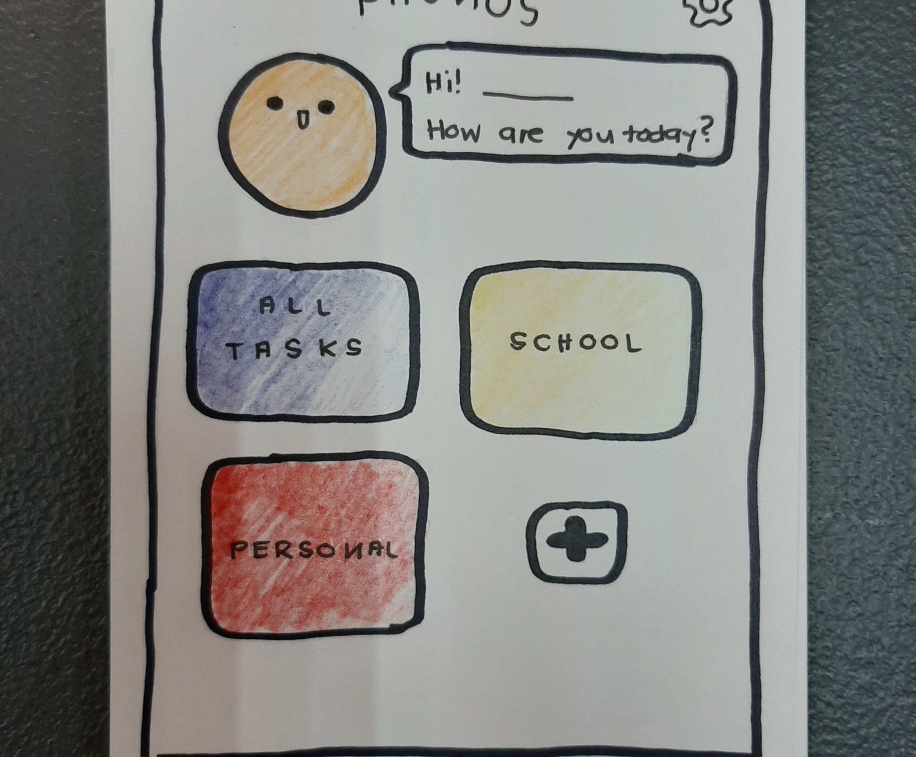
Simplistic Interface (Easy-to-use)
Room for Customization
Cute design and has an “Achievements” feature

Slide 17
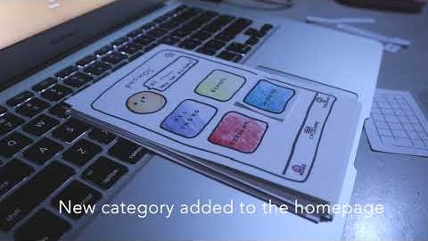
The Simulation

Slide 18
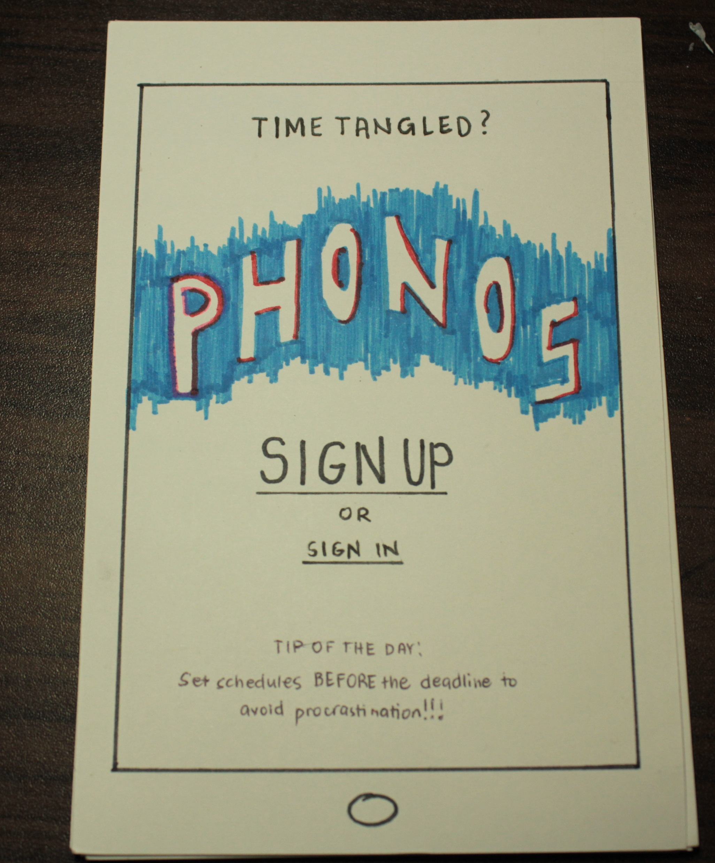
ALTERNATIVE PROTOTYPE
For functionality
Room for customization
A “Daily Planner” feature

Slide 19
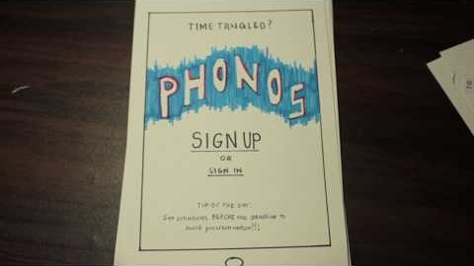
The Simulation

